Slide 1

Management Roundtable
How is your adoption going?

Slide 2
Roundtable Agenda
My perspectives; “A Tale of Two Cities”
Adoption of CET Designer
Dealership Process Change
How are the Manufacturers Performing?

Slide 3




Slide 4

Perspectives
Love the concept of intuitive technology that makes life easier
CET was the way to show the client what they were getting
Cost was never an impediment
Company owner wanted it early; found resistance from staff
Design leader says TRAINING, TRAINING, TRAINING
Today, 60% of projects utilize CET Designer

Slide 5




Slide 6
Perspectives
Firm was an early adopter and fully embraced of the concept
Ltd uses, bugs, crashes, PC requirements, slowed our usage
Is it a specification tool or a rendering tool???????
2011 renaissance- upgraded PC’s, new version of CET
3 of 7 designers use it religiously; of the 3- majority of projects
CET Designer does not reduce cost; provides increased value

Slide 7
Adoption of CET Designer
The merging roles of designers and salespeople at dealerships (hybrid)
2. How software is helping the industry to adjust to changing roles – and be strategic about it
3. How technology makes it possible for people to be cross-trained, assume cross-functional roles

Slide 8

What’s Holding You Back? {please share} This is the main content of our roundtable!
Where to you want your design process to go?
What do you need from Configura to help get there?
What can I do to help get your message across?

Slide 9
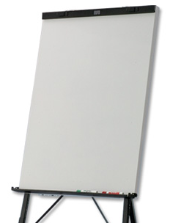
How are manufacturers performing?
Configura
Steelcase
Haworth
Teknion
Project Matrix
KI

Slide 10

THANKS FOR YOUR
PARTICIPATION & ENJOY

